Slide 1
Event Handling

Slide 2
Graphical User Interface (GUI)
Graphical User Interface (GUI) offers user interaction via some graphical components.
For example our underlying Operating System also offers GUI via window, frame, Panel, Button, Textfield, TextArea, Listbox, Combobox, Label, Checkbox etc.
These all are known as components. Using these components we can create an interactive user interface for an application.
GUI provides result to end user in response to raised events.
GUI is entirely based events.
For example clicking over a button, closing a window, opening a window, typing something in a text area etc.
These activities are known as events. GUI makes it easier for the end user to use an application. It also makes them interesting.

Slide 3
Graphical User Interface (GUI)
Examples of GUI Based Applications:
Automated Teller Machine (ATM)
Airline Ticketing System
Information Kiosks at railway stations
Mobile Applications
Navigation Systems

Slide 4
Event
Change in the state of an object is known as event.
Events are generated as result of user interaction with the graphical user interface components – Foreground events
For example, clicking on a button, moving the mouse, entering a character through keyboard, selecting an item from list, scrolling the page are the activities that causes an event to happen.
May also occur that are not directly used by interactions with a user interface – Background events
For example, an event may be generated when a timer expires, a counter exceeds a value, a software or hardware failure occurs, or an operation is completed.

Slide 5
Delegation Event Model
Graphical user interfaces (GUIs) are event driven - they generate events when the user interacts with them by clicking etc.
Standard procedure for generating and processing events.
Concept
A source generates an event and sends it to one or more listeners.
Listener simply waits until it receives an event.
One received, the listener processes the event and then returns.
Advantage is “the application logic that processes the events is cleanly separated from the user interface logic that generates those events”.
Note: the listeners must register with a source in order to receive an event notification.
Advantage is “notifications are only sent to the listeners that want to receive them”.

Slide 6
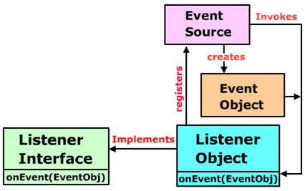
Delegation Event Model

Slide 7
Controls
Every user interface considers the following three main aspects:
UI elements : core visual elements the user eventually sees and interacts with. (next chapter – AWT)
Layouts: how UI elements should be organized on the screen and provide a final look and feel to the GUI (Graphical User Interface). (next chapter – AWT)
Behaviour: events which occur when the user interacts with UI elements. Covered in this chapter.

Slide 8
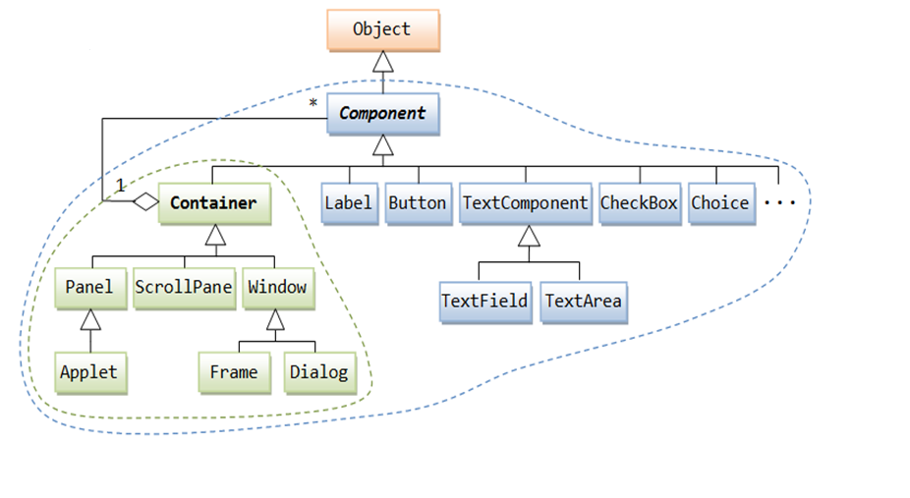
Controls
A Component is an abstract super class for GUI controls and it represents an object with graphical representation.

Slide 9
Event Sources
A source is an object that generates an event.
This occurs when internal state of an object changes in some way.
Sources may generate more than one type of an event.
A source must register listeners in order for the listeners to receive notifications about a specific type of event.
Each type of event has its own registration method.
where Type is the name of the event and el is a reference to the event listener.
For example, the method that registers a keyboard event listener is called addKeyListener( ).
A source must also provide a method that allows a listener to unregister an interest in a specific type of event.
public void addTypeListener(TypeListener el)
public void removeTypeListener(TypeListener el)

Slide 10
Event Listeners
A listener is an object that is notified when an event occurs.
It has two major requirements.
First, it must have been registered with one or more sources to receive notifications about specific types of events.
Second, it must implement methods to receive and process these notifications.
The methods that receive and process events are defined in a set of interfaces found in java.awt.event.
For example, the MouseMotionListener interface defines two methods to receive notifications when the mouse is dragged or moved.
When an event occurs, all registered listeners are notified and receive a copy of the event object. This is known as multicasting the event.
public interface EventListener

Slide 11
Event Classes
EventObject – superclass of all events, present in java.util
Constructor: EventObject (Object src) where src is the object that generates the event.
Two methods: Object getSource( ) which returns the source of the event and String toString( ) that returns the string equivalent of the event.
Class declaration
public class EventObject extends Object implements Serializable

Slide 12
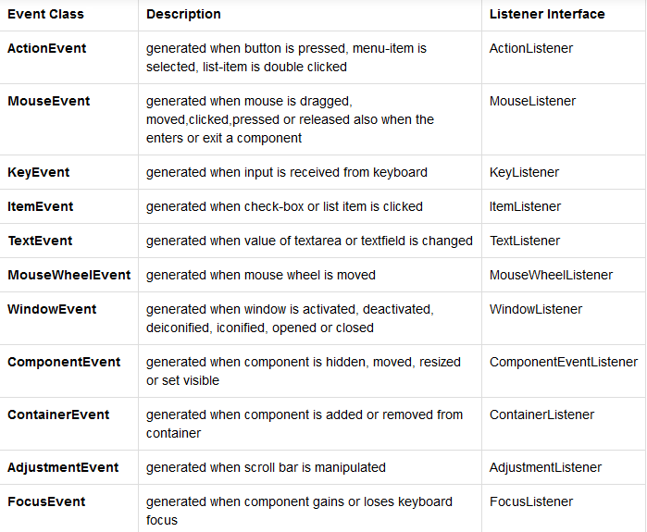
Event Classes

Slide 13
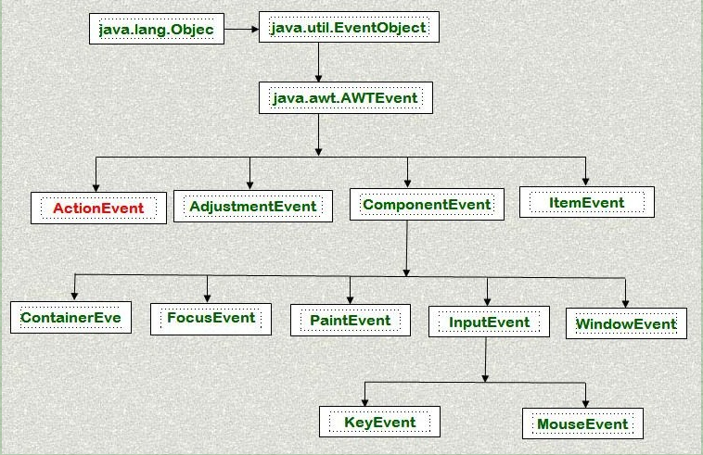
Event Classes

Slide 14
ActionEvent Class
Generated when a button is pressed, a list-item is double clicked, or a menu item is selected.
Class declaration
Constructors:
src is a reference to the object that generated this event.
The type of the event is specified by type, and its command string is cmd.
The argument modifiers indicates which modifier keys (ALT, CTRL and/or SHIFT) were pressed.
The when parameter specifies when the event occurred.
public class ActionEvent extends AWTEvent
ActionEvent(Object src, int type, String cmd)
ActionEvent(Object src, int type, String cmd, int modifiers)
ActionEvent(Object src, int type, String cmd, long when, int modifiers)

Slide 15
ActionEvent Class
Methods:
Obtain the command name for the invoking ActionEvent object by using the getActionCommand( ) method
For example, when a button is pressed, an action event is generated that has a command name equal to the label on that button.
The getModifiers( ) method returns a value that indicates which modifier keys (ALT, CTRL, META, and/or SHIFT) were pressed when the event was generated.
Returns the time at which the event took place. This is called the event’s timestamp.
String getActionCommand( )
int getModifiers( )
long getWhen( )

Slide 16
AdjustmentEvent Class
Generated by a scrollbar.
Class declaration
Fields:
static int UNIT_DECREMENT: The button at the end of the scrollbar was clicked to decrease its value.
static int UNIT_INCREMENT: The button at the end of the scrollbar was clicked to increment its value.
static int BLOCK_DECREMENT: The user clicked inside the scrollbar to decrease its value.
static int BLOCK_INCREMENT: The user clicked inside the scrollbar to increase its value.
static int TRACK: The slider was dragged.
static int ADJUSTMENT_VALUE_CHANGED: Indicates that a change has occurred.
public class AdjustmentEvent extends AWTEvent

Slide 17
AdjustmentEvent Class
Constructors:
src is a reference to the object that generated this event.
id equals ADJUSTMENT_VALUE_CHANGED.
Methods:
getAdjustible( ) returns the object that generated the event.
The type of the adjustment event may be obtained by the getAdjustmentType( ) method. It returns one of the constants that is defined by AdjustmentEvent.
AdjustmentEvent(Adjustable src, int id, int type, int data)
Adjustable getAdjustable( )
int getAdjustmentType( )

Slide 18
ComponentEvent Class
Generated when the size, position or visibility of a component is changed.
Class declaration
Fields:
static int COMPONENT_HIDDEN: The component was hidden.
static int COMPONENT_MOVED: The component was moved.
static int COMPONENT_RESIZED: The component was resized.
static int COMPONENT_SHOWN: The component was visible.
Constructors:
src is a reference to the object that generated this event.
Type of the event is specified by type.
Methods:
getComponent( ) returns the component that generated the event.
public class ComponentEvent extends AWTEvent
ComponentEvent(Component src, int type)
Component getComponent( )

Slide 19
ContainerEvent Class
Generated when a component is added to or removed from a container.
Class declaration
Fields:
static int COMPONENT_ADDED: The component was added.
static int COMPONENT_REMOVED: The component was removed.
Constructors:
src is a reference to the object that generated this event.
Type of the event is specified by type.
The component that has been added to or removed from the container is comp.
Methods:
getContainer( ) returns the container that generated the event.
getChild( ) returns a reference to the component that was added or removed from the container.
public class ContainerEvent extends AWTEvent
ContainerEvent(Component src, int type, Component comp)
Container getContainer( )
Component getChild( )

Slide 20
FocusEvent Class
Generated when a component gains or looses input focus
Class declaration
Fields:
static int FOCUS_GAINED
static int FOCUS_LOST
Constructors:
src is a reference to the object that generated this event.
The type of the event is specified by type.
The argument temporaryFlag is set to true if the focus event is temporary. Otherwise, it is set to false.
The other component involved in the focus change, called the opposite component, is passed in other.
public class FocusEvent extends AWTEvent
FocusEvent(Component src, int type)
FocusEvent(Component src, int type, boolean temporaryFlag)
Focus Event(Component src, int type, boolean temporaryFlag, Component other)

Slide 21
FocusEvent Class
Methods:
Determine the other component by called getOppositeComponent( ) method
isTemporary( ) method indicates if this focus change is temporary. Returns true if the change is temporary. Otherwise, it returns false.
Component getOppositeComponent( )
boolean isTemporary( )

Slide 22
ItemEvent Class
Generated when a checkbox or a list item is clicked or when a checkable menu item is selected or deselected.
Class declaration
Fields:
static int DESELECTED : The user deselected an item.
static int SELECTED : The user selected an item.
static int ITEM_STATE_CHANGED: Signifies a change of state.
Constructors:
src is a reference to the object that generated this event.
The type of the event is specified by type.
The specific item that generated the item event is passed in entry.
The current state of that item is in state.
public class ItemEvent extends AWTEvent
ItemEvent(ItemSelectable src, int type, Object entry, int state)

Slide 23
ItemEvent Class
Methods:
getItem( ) method can be used to obtain a reference to the item that generated an event.
getItemSelectable( ) method can be used to obtain a reference to the ItemSelectable object that generated the event. List and choice are examples.
The getStateChange( ) method returns the state change (i.e., SELECTED or DESELECTED) for the event.
Object getItem( )
ItemSelectable getItemSelectable( )
int getStateChange( )

Slide 24
KeyEvent Class
Generated when keyboard input occurs.
Class declaration
Fields:
static int KEY_PRESSED
static int KEY_RELEASED
static int KEY_TYPED (pressing the SHIFT key does not generate a character)
Static int VK_0 throught VK_9, VK_A through VK_Z define the ASCII equivalents of the numbers and letters. Here, VK means Virtual Key Codes.
Constructors:
src is a reference to the object that generated this event.
The type of the event is specified by type.
The system time when the key was pressed is passed in when.
The modifiers argument indicates which modifiers were pressed when this key event occurred.
The virtual key code, such as VK_UP, VK_A, and so forth, is passed in code.
The character equivalent (if one exists) is passed in ch. If no valid character exists, then ch contains CHAR_UNDEFINED. For KEY_TYPED events, code will contain VK_UNDEFINED.
public class KeyEvent extends AWTEvent
KeyEvent(Component src, int type, long when, int modifiers, int code)
KeyEvent(Component src, int type, long when, int modifiers, int code, char ch)

Slide 25
KeyEvent Class
Methods:
getKeyChar( ) method returns the character that was entered.
getKeyCode( ) method returns the key code
char getKeyChar( )
int getKeyCode( )

Slide 26
MouseEvent Class
Generated when mouse input occurs.
Class declaration
Fields:
MOUSE_CLICKED, MOUSE_DRAGGED, MOUSE_ENTERED, MOUSE_EXITED, MOUSE_MOVED, MOUSE_PRESSED, MOUSE_RELEASED, MOUSE_WHEEL
Constructors:
src is a reference to the object that generated this event.
The type of the event is specified by type.
The system time when the mouse event occurred is passed in when.
The modifiers argument indicates which modifiers were pressed when this mouse event occurred.
The coordinates of the mouse are passed in x and y.
The click counts are passed in clicks.
The triggersPopup flag indicates if this event causes a pop-up menu to appear.
public class MouseEvent extends AWTEvent
MouseEvent(Component src, int type, long when, int modifiers, int x, int y, int clicks, boolean triggersPopup)

Slide 27
MouseEvent Class
Methods:
Returns the X and Y coordinated.
getPoint( ) method obtains the coordinates of the mouse.
translatePoint( ) method changes the location of the event.
getClickCount( ) method obtains the number of mouse clicks for this event.
isPopupTrigger( ) method tests if this event causes a pop-up menu to appear.
int getX( )
int getY( )
Point getPoint( )
void translatePoint(int x, int y)
int getClickCount( )
boolean isPopupTrigger( )

Slide 28
TextEvent Class
Generated by text fields and text areas when characters are entered by user programs.
Class declaration
Fields:
TEXT_VALUE_CHANGED
Constructors:
src is a reference to the object that generated this event.
The type of the event is specified by type.
public class TextEvent extends AWTEvent
TextEvent(Object src, int type)

Slide 29
WindowEvent Class
Generated by change in the state of a window.
Class declaration
Fields:
WINDOW_ACTIVATED, WINDOW_CLOSED, WINDOW_CLOSING, WINDOW_DEACTIVATED,WINDOW_DEICONIFIED, WINDOW_OPENED, WINDOW_GAINED_FOCUS, WINDOW_ICONIFIED, WINDOW_LOST_FOCUS, WINOW_STATE_CHANGED
Constructors:
src is a reference to the object that generated this event.
The type of the event is specified by type.
other specifies the opposite window when a focus event occurs.
fromState is the prior state of the window and toState is the new state of the window.
public class WindowEvent extends AWTEvent
WindowEvent(Window src, int type)
WindowEvent(Window src, int type, Window other)
WindowEvent(Window src, int type, int fromState, int toState)
WindowEvent(Window src, int type, Window other, int fromState, int toState)

Slide 30
WindowEvent Class
Methods:
Returns the Window object that generated the event.
Return the opposite window (when a focus event has occurred), the previous window state, and the current window state.
Window getWindow( )
Window getOppositeWindow()
int getOldState()
int getNewState()

Slide 31
AWT Components and Events They Generate
Button | ActionEvent | User clicked the button
Checkbox | ItemEvent | User selected or deselected an item
CheckboxMenuItem | ItemEvent | User selected or deselected an item
Choice | ItemEvent | User selected or deselected an item
Component | ComponentEvent | Component moved, resized, hidden, or shown
 | FocusEvent | Component gained or loast focus
 | KeyEvent | User pressed or released a key
 | MouseEvent | User pressed or released a mouse button, mouse entered or exited a component, or user moved or dragged mouse.
Container | ContainerEvent | Component added to or removed from Container
List | ActionEvent | User double-clicked on a List item
 | ItemEvent | User selected or deselected an item
MenuItem | ActionEvent | User selected a menu item
ScrollBar | AdjustmentEvent | User moved the scrollbar
TextComponent | TextEvent | User changed the text
TextField | ActionEvent | User pressed Enter (finished editing text)
Window | WindowEvent | Window opened, closed, iconified, deiconified, or close requested

Slide 32
Event Listener Interfaces
Interface | Description
ActionListener | Defines the actionPerformed() method to receive and process action events.
MouseListener | Defines five methods to receive mouse events, such as when a mouse is clicked, pressed, released, enters, or exits a component
MouseMotionListener | Defines two methods to receive events, such as when a mouse is dragged or moved.
AdjustmentListner | Defines the adjustmentValueChanged() method to receive and processthe adjustment events.
TextListener | Defines the textValueChanged() method to receive and process an event when the text value changes.
WindowListener | Defines seven window methods to receive events.
ItemListener | Defines the itemStateChanged() method when an item has been selected or deselected by the user.

Slide 33
Event Listener Interfaces
INTERFACE | INTERFACE METHODS | ADD METHOD | EVENT CLASS
ActionListener | actionPerformed (ActionEvent ae) | addActionListener() | ActionEvent
AdjustmentListener | adjustmentValueChanged(AdjustmentEvent ae) | addAdjustmentListener() | AdjustmentEvent
ComponentListener | componentHidden(ComponentEvent ce) | addComponentListener() | ComponentEvent
 | componentMoved(ComponentEvent ce)
 | componentResized(ComponentEvent ce)
 | componentShown(ComponentEvent ce)
ContainerListener | componentAdded(ComponentEvent ce) | addContainerListener() | ContainerEvent
 | componentRemoved(ComponentEvent ce)
FocusListener | focusGained(FocusEvent fe) | addFocusListener() | FocusEvent
 | focusLost(FocusEvent fe)
ItemListener | itemStateChanged(ItemEvent ie) | addItemListener() | ItemEvent
KeyListener | keyPressed(KeyEvent ke) | addKeyListener() | KeyEvent
 | keyReleased(KeyEvent ke)
 | keyTyped(KeyEvent ke)

Slide 34
Event Listener Interfaces
INTERFACE | INTERFACE METHODS | ADD METHOD | EVENT CLASS
MouseListener | mouseClicked(MouseEvent me) | addMouseListener() | MouseEvent
 | mouseEntered(MouseEvent me)
 | mouseExited(MouseEvent me)
 | mousePressed(MouseEvent me)
 | mouseReleased(MouseEvent me)
MouseMotionListener | mouseDragged(MouseEvent me) | addMouseMotionListener() | MouseEvent
 | mouseMoved(MouseEvent me)
TextListener | textValueChanged(TextEvent te) | addTextListener() | TextEvent
WindowListener | windowActivated(WindowEvent we) | addWindowListener() | WindowEvent
 | windowClosed(WindowEvent we)
 | windowClosing(WindowEvent we)
 | windowDeactivated(WindowEvent we)
 | windowDeiconified(WindowEvent we)
 | windowIconified(WindowEvent we)
 | windowOpened(WindowEvent we)

Slide 35
Handling Various Events
Mouse Events
Refer the program MouseEvents.java
Keyboard Events
Refer the program SimpleKey.java & KeyEvents.java
Action Events
Refer the program ActionExample.java
Item Events
Refer the program ItemExample.java & ItemChoiceExample.java
Adjustment Events
Refer the program AdjustmentExample.java
Component Events
Refer the program ComponentExample.java
Container Events
Refer the program ContainerExample.java
Focus Events
Refer the program Focus.java
Window Events
Refer the program WindowDemo.java

Slide 36
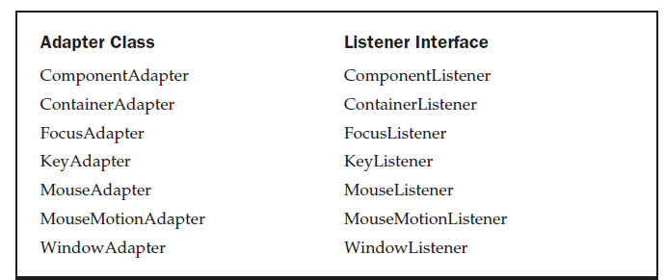
Adapter Classes
Provides an empty implementation of all methods in an event listener interface.
Useful when you want to receive and process only some of the events that are handled by a particular event listener interface.
Refer to AdapterDemo.java

Slide 37
Inner Classes
A class that is defined within other class or even within an expression.
If inner class is not used, then init( ) method instantiates adapter and provides this object as an argument to the listener method.
A reference to the applet is supplied as an argument to the adapter constructor and this reference is stored in an instance variable for future use.
Refer the program MousePressedDemo.java
If inner class is used, then adapter is defined within the scope of the main class that instantiates the adapter and hence no longer its required to store the reference.
In other words, now the adapter class acts as a inner class.
Refer the program InnerClassDemo.java

Slide 38
Anonymous Inner Classes
Is the one that is not assigned any name.
Adapter class that acts as a inner class does not require to be written with a name.
The init( ) method calls the listener method. Its argument is an expression that defines and instantiates an anonymous inner class.
Refer the program AnonymousInnerClassDemo.java

Slide 39
THANK YOU!!
ANY QUESTIONS??

